Slide 1
Application Form for Admission to Graduate Studies at UPR - Río Piedras Campus
Informative Tutorial
UPR –Río Piedras
Dean’s Office of Graduate Studies and Research

Slide 2
General Information
You can access the following links to complete the Application Form for Admission to Graduate Studies at UPR - Rio Piedras Campus and learn about the graduate academic offerings and their requisites for admission:
Admission Application Form
https://solicitud.upr.edu/
Dean’s Office of Graduate Studies and Research
https://graduados.uprrp.edu

Slide 3
What should I do before completing the application?
Get to know the graduate academic offerings that our Rio Piedras Campus offers. Click the following link to access the document: https://drive.google.com/file/d/1N5oVsPsbzFW45jiDC2Cb6FKf2vOURzPO/view
Check the admission requirements for the program of your interest on the following link: https://graduados.uprrp.edu/estudiantiles/requisitosgraduados/
Identify the deadlines and the documents you must submit as part of your application for graduate studies.
Anyone interested in submitting an application for graduate studies must have, at least, a bachelor's degree

Slide 4
What should I do before completing the application?
Have available the academic transcripts for all degrees earned.
For example: Bachelor’s academic transcript, Master’s or Juris Doctorate academic transcript.
You must also have evidence of the conferred Bachelor’s or Master’s degree.
Identify the deadlines and the documents you must submit as part of your application for graduate studies.
Anyone interested in submitting an application for graduate studies must have, at least, a bachelor's degree.

Slide 5
CREATING YOUR ACCOUNT

Slide 6
UPR ADMISSIONS PORTAL
You will be able to choose your preferred language, Spanish or English, when completing the application form.
You must select “Create New Account”

Slide 7
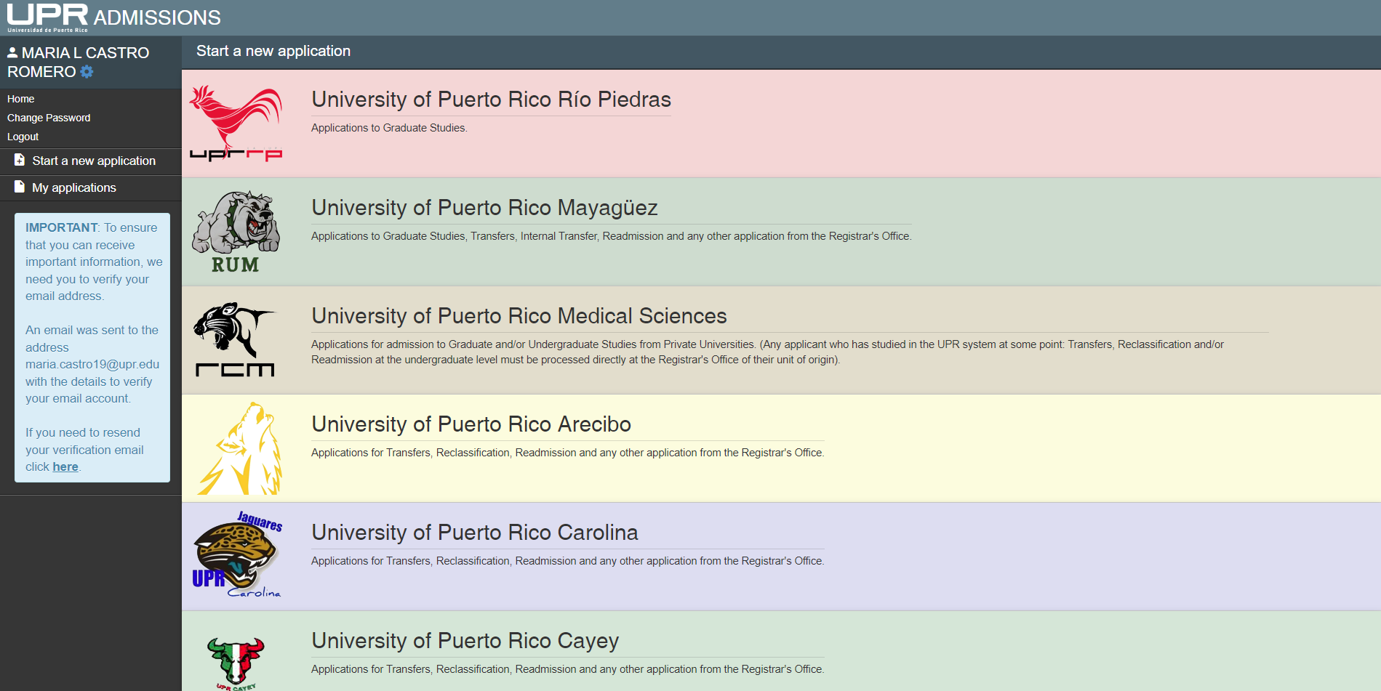
Graduate Admission Application UPR-Río Piedras
You must select University of Puerto Rico Río Piedras

Slide 8
Available Admission Applications

Slide 9
1
2
Once the account has been created your name will appear on the left and you will see the fields you need to fill out. The application consists of 9 parts. Important! Make sure to click save (1) once each part is completed and next (2) before continuing.

Slide 10
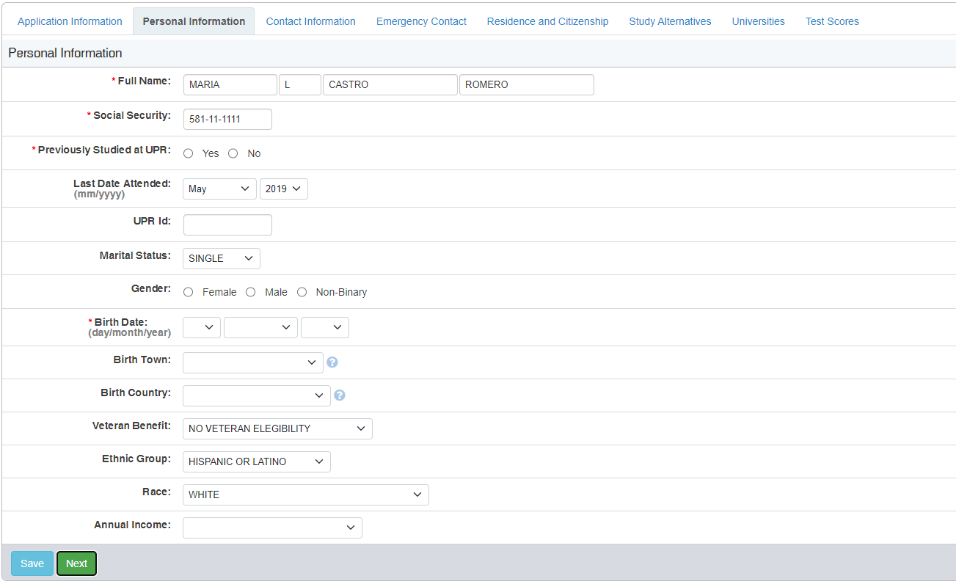
Personal Information
If you have previously studied in the UPR System, you must write the student number the University assigned you back then.

Slide 11
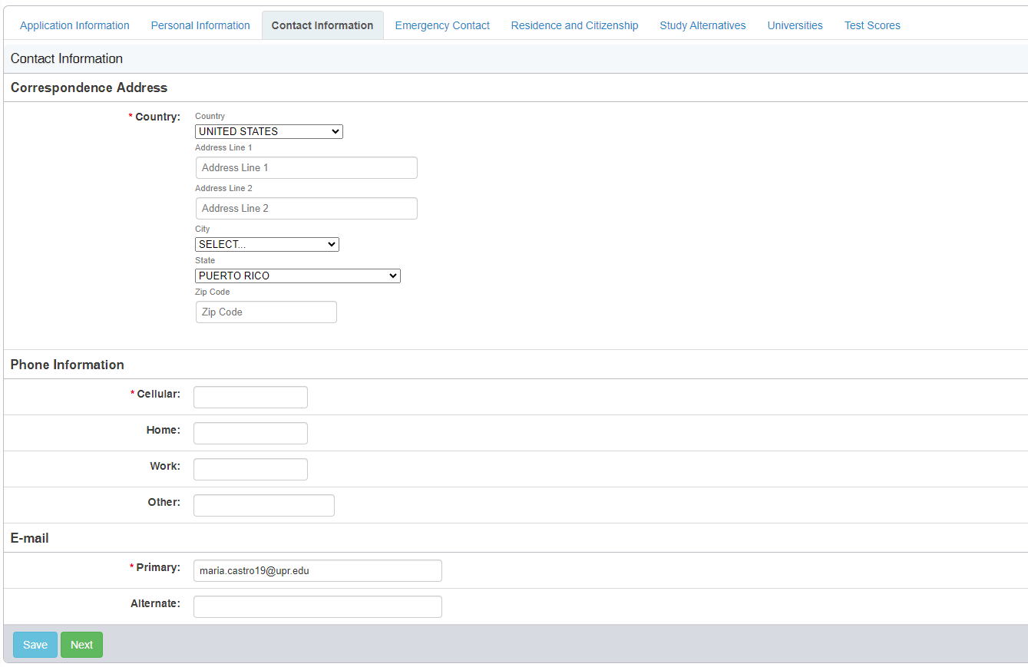
Contact Information
If you were born in the United States of America or Puerto Rico, you must select UNITED STATES.

Slide 12
Emergency Contact

Slide 13
Residency and Citizenship - Local Applicants

Slide 14
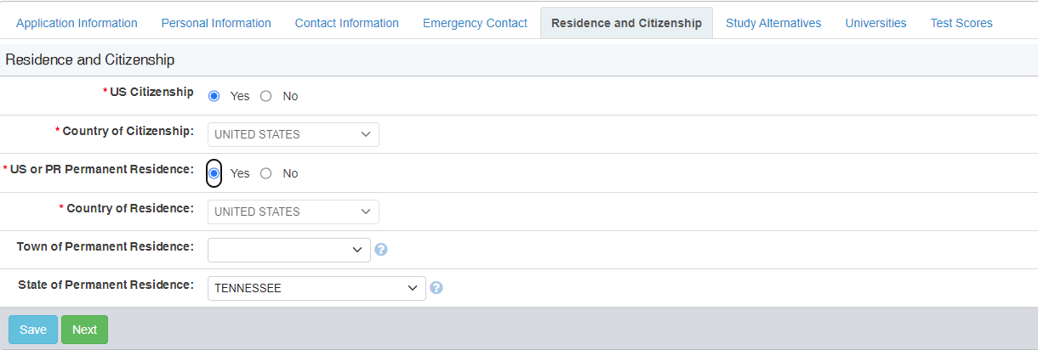
Residency and Citizenship - Applicants residing in USA

Slide 15
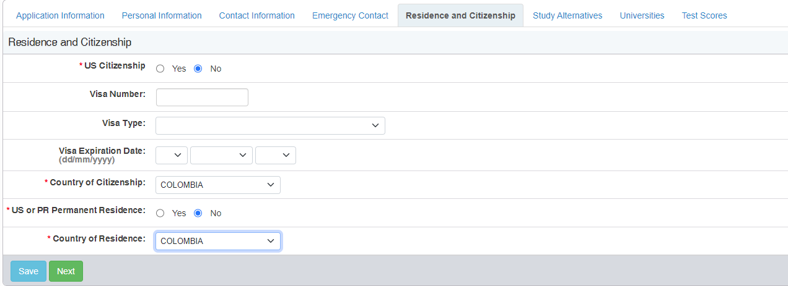
Residency and Citizenship - International Students

Slide 16
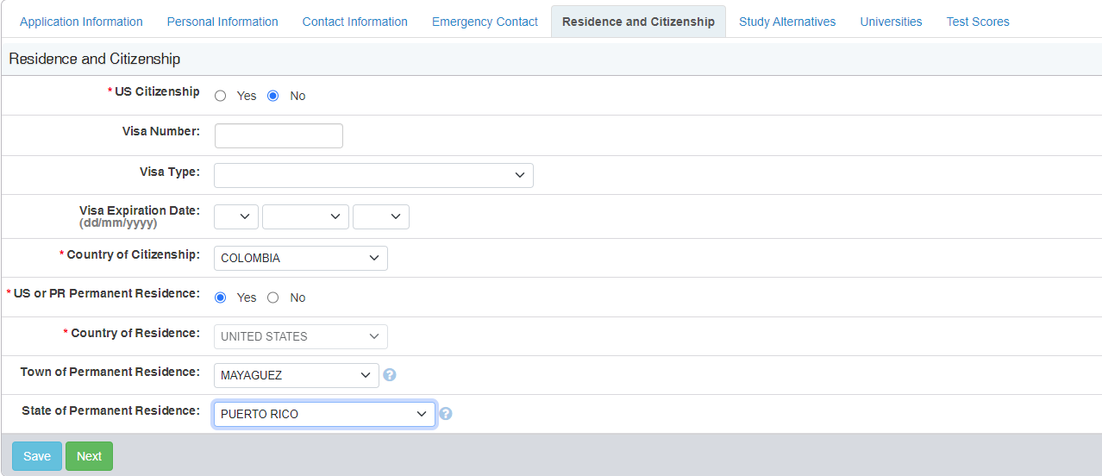
Residency and Citizenship - International Students in Puerto Rico
If you have an active visa you must log the pertinent information regarding the visa

Slide 17
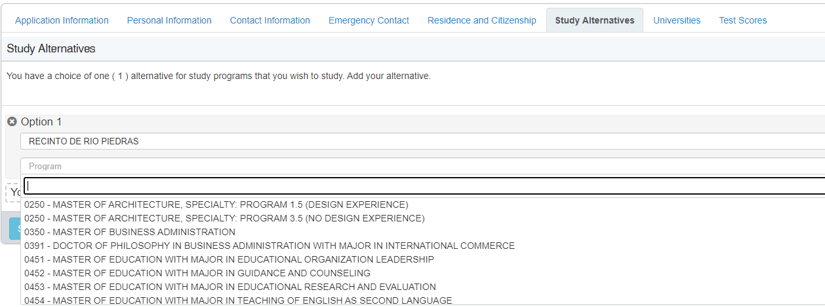
Study Alternatives
The student must select only one (1) option per application form.

Slide 18
Universities
You must place the cursor here and write the name of the university you attended.

Slide 19
Universities
You must place the cursor here and write the name of the university you attended.

Slide 20
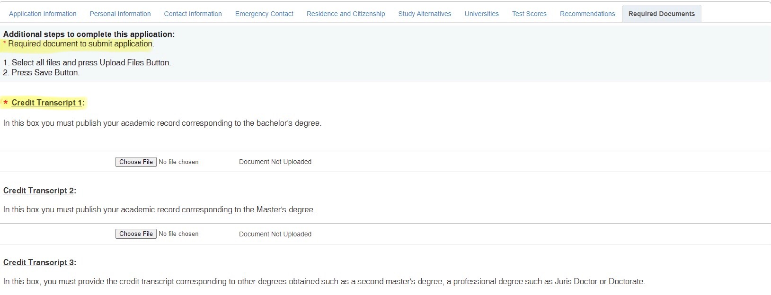
Required Documents

Slide 21
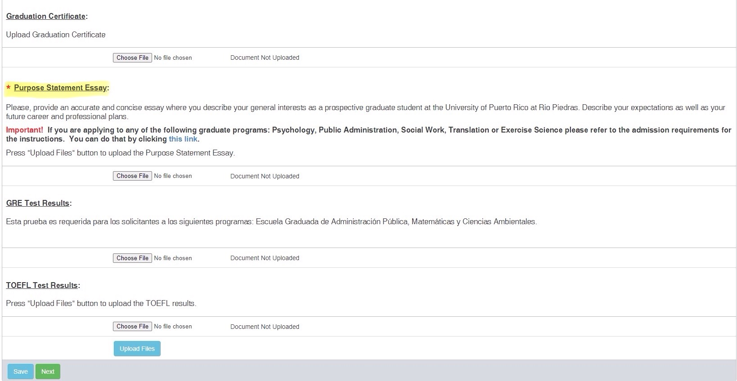
Required Documents
2
1
You must download the academic transcripts, degree certificates, essays, and your resume or curriculum vitae. The documents identified with an * are required. Once you downloaded each of them, select UPLOAD FILES.

Slide 22
Recommendations
It is important that you check how many letters of recommendation are required by the academic program you are interested in. Some programs require 2 letters, while others require 3. You can add the contact information of up to 4 people.

Slide 23
Recommendations

Slide 24
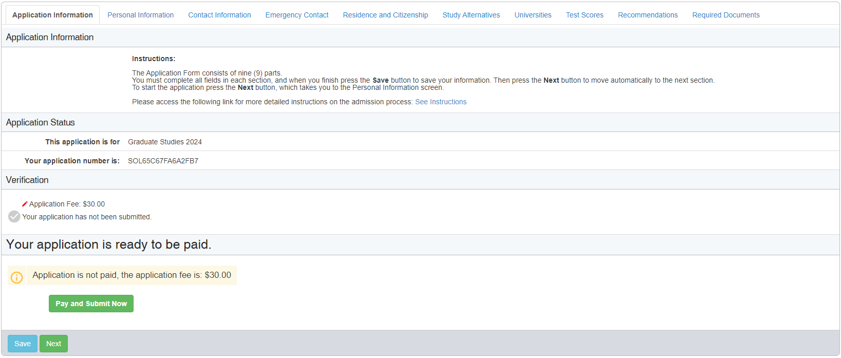
Application Form with All Needed Documents

Slide 25
Filing of Graduate Admission Application Processing Fee
In order to submit the graduate admission application form you must issue the corresponding payment.
The payment is made electronically from the platform using the following payment methods:
ATH (Banco Popular)

Slide 26
Cost Breakdown Per Application
Graduate Admission Application
$30.00
Graduate Admission Application (Trimester)
$30.00
Graduate Level Study Permit Application
$30.00
Graduate Readmission Application
$35.00

Slide 27
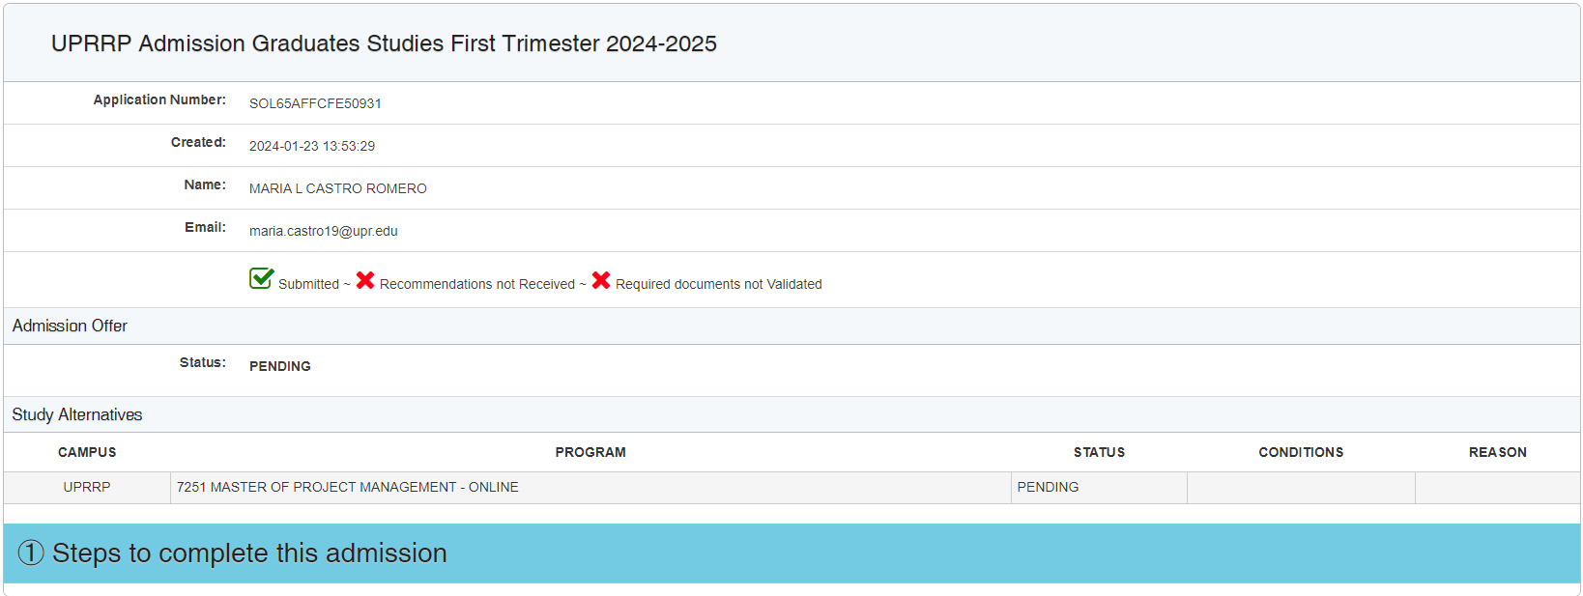
Submitted Application
María L. Castro Romero
maria.castro19@upr.edu

Slide 28
Additional Information
María L. Castro Romero
Graduate Admissions Coordinator
maria.castro19@upr.edu or admisiones.degi@upr.edu

